Slide 1



Servlets
Server applications
www.supinfo.com
Copyright © SUPINFO. All rights reserved
Notes:
© SUPINFO International University - http://www.supinfo.com
SUPINFO vous permet de partager ce document
Vous êtes libre de :
Partager — reproduire, distribuer et communiquer ce document Remixer — modifier ce document
A condition de respecter les règles suivantes :
Indication obligatoire de la paternité — Vous devez obligatoirement préciser l’origine « SUPINFO » du document au début de celui-ci de la même manière qu’indiqué par SUPINFO International University – Notamment en laissant obligatoirement la première et la dernière page du document, mais pas d'une manière qui suggérerait que SUPINFO International University vous soutiennent ou approuvent votre utilisation du document, surtout si vous le modifiez. Dans ce dernier cas, il vous faudra obligatoirement supprimer le texte « SUPINFO Official Document » en tête de page et préciser notamment la page indiquant votre identité et les modifications principales apportées.
En dehors de ces dispositions, aucune autre modification de la première et de la dernière page du document n’est autorisée.
NOTE IMPORTANTE : Ce document est mis à disposition selon le contrat CC-BY-NC-SA Creative Commons disponible en ligne http://creativecommons.org/licenses ou par courrier postal à Creative Commons, 171 Second Street, Suite 300, San Francisco, California 94105, USA modifié en ce sens que la première et la dernière page du document ne peuvent être supprimées en cas de reproduction, distribution, communication ou modification. Vous pouvez donc reproduire, remixer, arranger et adapter ce document à des fins non commerciales tant que vous respectez les règles de paternité et que les nouveaux documents sont protégés selon des termes identiques. Les autorisations au-delà du champ de cette licence peuvent être obtenues à support@supinfo.com.
© SUPINFO International University – EDUCINVEST - Rue Ducale, 29 - 1000 Brussels Belgium . www.supinfo.com

Slide 2


Course objectives
Servlets
By completing this course, you will:
Understand what a servlet is
Learn how to create basic and advanced servlets

Slide 3

Course topics
Servlets
Course’s plan
Introduction
Servlet Hierarchy
Request and Response processing
Deployment Descriptor
The Web Container Model
What’s new in Servlet 3.0 ?

Slide 4
Introduction
Servlets

Slide 5

Presentation
Introduction
Classes executed on the server
Dynamic request processing
Dynamic response producing
Generally used on a Web server

Slide 6
Advantages
Introduction
Efficient :
JVM’s memory management
Only one instance per Servlet
One request = One Thread
…
Useful :
Cookies
Sessions
Extensible and flexible :
Run on numerous platforms and HTTP servers without change
Java Language ! (powerful, reliable with a lot of API)

Slide 7
Drawbacks
Introduction
Heavy when used for graphical design
Unsuitable for generating HTML and JavaScript code
But JSP does (we’ll see it later)
Needs a Java Runtime Environment on the server
Needs a special “Servlet Container" on web server

Slide 8
Dynamic process
Introduction
Basic HTTP request handling
Static HTML
≠
Servlet request handling
Dynamic response generated

Slide 9
Basic request
Introduction
1. Connection and request from client
2. Look for the target
3. Page transferred to the client then disconnection

Slide 10
Servlet request: first call
Introduction
1. Connection and request from client
4. Response transferred then disconnection
3. Servlet executes service() method
2. Servlet is created and initialized by init() method

Slide 11
Servlet request: other calls
Introduction
1. Connection and request from client
3. Response transferred then disconnection
2. Servlet executes service() method

Slide 12


Servlet Container
Introduction
Servlet container implements the web component contract of the Java EE architecture
Also known as a web container
Examples of Servlet containers are :
Tomcat
Jetty
Oracle iPlanet Web Server

Slide 13




Servlet-Based Frameworks
Introduction
Few companies used Servlet technology alone…
But a lot of companies used Servlet-based Frameworks !
A large number exists :
Struts
JSF
Spring MVC
Wicket
Grails
…

Slide 14
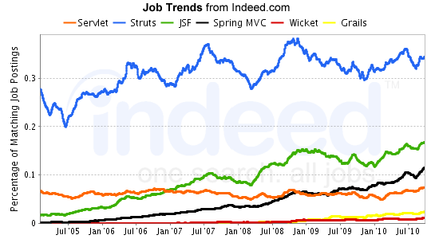
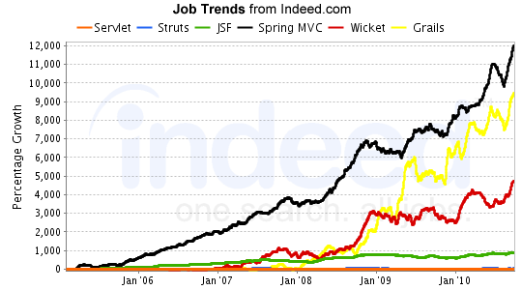
Servlet-Based Frameworks
Introduction

Slide 15


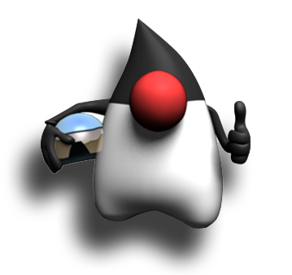
Stop-and-think
Introduction
Do you have any questions ?
???

Slide 16
Servlet Hierarchy
Servlets

Slide 17
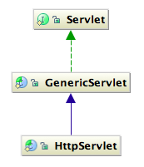
Presentation
Servlet Hierarchy
Servlet hierarchy is composed of :
Servlet interface
GenericServlet abstract class
HttpServlet abstract class

Slide 18
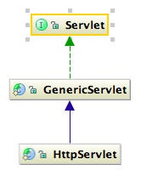
Servlet interface
Servlet Hierarchy
Defines methods a servlet must implement :
How the servlet is initialized?
What services does it provide?
How is it destroyed?
…

Slide 19
Servlet interface
Servlet Hierarchy
Methods overview
Method | Description
void init(ServletConfig sc) | Called by the servlet container to make the servlet active
void service(ServletRequest req, ServletResponse res) | Called by the servlet container to respond to a request
void destroy() | Called by the servlet container to make the servlet out of service
ServletConfig getServletConfig() | Returns informations about initialization and startup parameters
String getServletInfo() | Returns information about the servlet

Slide 20
Servlet interface
Servlet Hierarchy
Example 1/2
public class MyServlet implements Servlet {
private ServletConfig config;
@Override
public void destroy() {
// ...
}
@Override
public void init(ServletConfig sc) {
this.config = sc;
}
...

Slide 21
Servlet interface
Servlet Hierarchy
Example 2/2
...
@Override
public ServletConfig getServletConfig() {
return this.config;
}
@Override
public String getServletInfo() {
return "MyServlet is the best !!";
}
@Override
public void service(ServletRequest req,
ServletResponse res) {
res.getWriter().println("Hello world");
}
}
Notes:
In order to send a response to the client, you can use the ServletResponse in order to retrieve a PrintWriter.
This writer allows you to send a response which will be displayed in the browser of the client.
You can also retrieve the ServletOutputStream thanks to the getOutputStream() method of the ServletResponse.

Slide 22
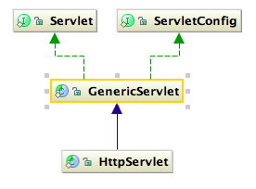
GenericServlet class
Servlet Hierarchy
An independent-protocol Servlet
Implements :
Servlet
ServletConfig
You just need to define the service method

Slide 23
GenericServlet class
Servlet Hierarchy
Example :
public class MyServlet extends GenericServlet {
@Override
public void service(ServletRequest req,
ServletResponse res) {
// ... Do whatever you want
}
}

Slide 24
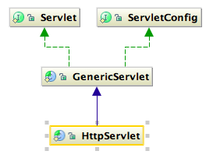
HttpServlet class
Servlet Hierarchy
A Servlet suitable for Web sites
Handles HTTP methods :
GET requests with doGet(…)
POST requests with doPost(…)
PUT requests with doPut(…)
Etc…
You can override one or several of them

Slide 25
HttpServlet class
Servlet Hierarchy
How does it work?
request Get
doGet()
response
service()
request Post
doPost()
Client
response
HttpServlet
Be Careful: doGet(), doPost() and others, are called by
the HttpServlet implementation of the service() method.
If it is overridden, the HTTP handler methods will not be called!
Notes:
Don't overrides methods you don't need, only the ones you use.

Slide 26
HttpServlet class
Servlet Hierarchy
Methods overview
Method | Description
void service(HttpServletRequest req, HttpServletResponse res) | Called by the servlet container to respond to a request
void doGet(HttpServletRequest req, HttpServletResponse res) | Handles GET request
void doPost(HttpServletRequest req, HttpServletResponse res) | Handles POST request
void doPut(HttpServletRequest req, HttpServletResponse res) | Handles PUT requests, used to send a file on the server
void doDelete(HttpServletRequest req, HttpServletResponse res) | Handles DELETE requests, used to delete a file on the server
…. | ….

Slide 27
HttpServlet class
Servlet Hierarchy
Example
public class MyServlet extends HttpServlet {
@Override
public void doGet(HttpServletRequest req,
HttpServletResponse res) {
// ... Do whatever you want
}
@Override
public void doPost(HttpServletRequest req,
HttpServletResponse res) {
// ... Do whatever you want here too ...
}
}

Slide 28
Stop-and-think
Servlet Hierarchy
Do you have any questions ?
???

Slide 29
Request and Response processing
Servlets
Well, can I interact with the request? And the response?

Slide 30
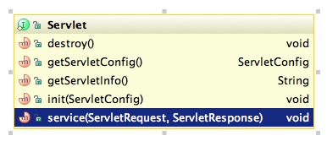
Introduction
Request and Response processing
The Servlet service() method owns :
A ServletRequest representing a Request
A ServletResponse representing a Response
You can use them!

Slide 31
ServletRequest
Request and Response processing
The interface for a request
Useful to retrieve :
Parameters
Attributes
Server name and port
Protocol
…

Slide 32
ServletRequest
Request and Response processing
Methods overview
Method | Description
String getParameter(String name) Map getParameterMap() | Get one or all parameters value or name in the request
Object getAttribute() void setAttribute(String name, Object value) | Get and set an attribute to the request
String getServerName() int getServerPort() | Get the server name and port
String getRemoteAddr() String getRemoteHost() int getRemotePort() | Get the address, the hostname and the port of the client
boolean isSecure() | Indicates if the request was made using a secure channel such as HTTPS

Slide 33
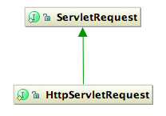
HttpServletRequest
Request and Response processing
The interface for an HTTP request
Useful to retrieve :
The session associated to the request
The header of the request
Cookies
…

Slide 34
HttpServletRequest
Request and Response processing
Methods overview
Method | Description
HttpSession getSession() HttpSession getSession(boolean create) | Get the session associated to the request
String getHeader(String name) | Get the value of the specified header
Cookie[] getCookies() | Get the cookies sent with the request

Slide 35
ServletResponse
Request and Response processing
The interface for a response
Useful to retrieve :
The output stream of the response
A PrintWriter
…

Slide 36
ServletResponse
Request and Response processing
Methods overview
Method | Description
ServletOutputStream getOutputStream() | Get the output stream of the servlet, useful for binary data
PrintWriter getWriter() | Get a writer, useful to send textual response to the client
void setContentType(String content) | Set the mime type of the response content, like "text/html"
Be Careful: You can’t use getOutputStream() and getWriter() together.
Calling both in a servlet gets an IllegalStateException.

Slide 37
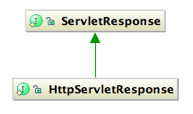
HttpServletResponse
Request and Response processing
The interface for an HTTP response
Useful to :
Add cookies
Redirect the client
…

Slide 38
HttpServletResponse
Request and Response processing
Methods overview
Method | Description
void addCookie(Cookie c) | Add a cookie to the response
void sendRedirect(String location) | Redirect the client to the specified location

Slide 39
Example
Request and Response processing
public class MyServlet extends HttpServlet {
@Override
protected void doGet(HttpServletRequest req, HttpServletResponse resp) {
String userName = req.getParameter("userName");
resp.setContentType("text/html");
PrintWriter out = resp.getWriter();
out.println("<html>");
out.println("<head>");
out.println("<title>My Servlet</title>");
out.println("</head>");
out.println("<body>");
out.println("<h1> Hello " + userName + "! </h1>");
out.println("</body>");
out.println("</html>");
}
}

Slide 40
Stop-and-think
Request and Response processing
Do you have any questions ?
???

Slide 41
Deployment Descriptor
Servlets
I’ve got my servlet, and now?

Slide 42
Introduction
Deployment Descriptor
A Servlet application has always (or almost) a deployment descriptor :
/WEB-INF/web.xml
It defines :
The servlets classes
The servlets mappings
The filters classes
The filters mappings
The welcome files
The application resources
And other stuffs…

Slide 43
web.xml
Deployment Descriptor
<?xml version="1.0" encoding="UTF-8"?>
<web-app xmlns=...>
<display-name>MyApplication</display-name>
<welcome-file-list>
<welcome-file>index.html</welcome-file>
<welcome-file>index.jsp</welcome-file>
</welcome-file-list>
<!-- Servlet declarations -->
<!-- Servlet mappings -->
<!– Other stuffs -->
</web-app>

Slide 44
Servlet declaration and mapping
Deployment Descriptor
When you create a servlet, in order to use it, you must
Declare it in a servlet block in the web.xml
Give it a name
Give the “Fully Qualified Name” of the servlet
Map it to an url-pattern in a servlet-mapping block in the web.xml

Slide 45
Servlet declaration and mapping
Deployment Descriptor
Example :
The servlet-name in both blocks servlet and servlet-mapping must be the same !
<servlet>
<servlet-name>MyServlet</servlet-name>
<servlet-class>com.supinfo.myapp.MyServlet</servlet-class>
</servlet>
<servlet-mapping>
<servlet-name>MyServlet</servlet-name>
<url-pattern>/Hello</url-pattern>
</servlet-mapping>

Slide 46
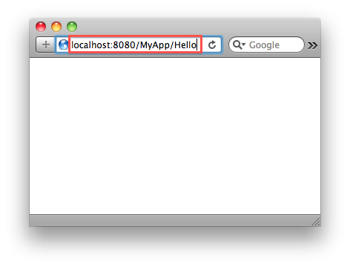
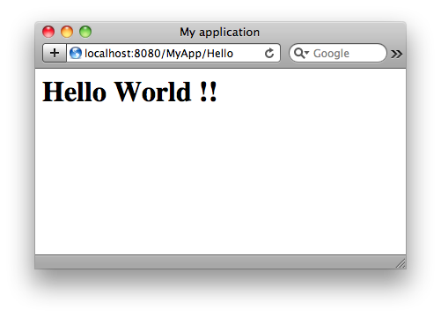
How it works?
Deployment Descriptor
1
5
<servlet>
<servlet-name>MyServlet</servlet-name>
<servlet-class>com.supinfo.myapp.MyServlet</servlet-class>
</servlet>
<servlet-mapping>
<servlet-name>MyServlet</servlet-name>
<url-pattern>/Hello</url-pattern>
</servlet-mapping>
4
3
2
Notes:
1 – The user requests an URL
2 – The URL is searched in the web.xml in the blocks url-pattern of all servlet-mapping
3 – The URL is matched, so the name of the servlet is searched in servlet blocks
4 – The servlet associated to the servlet name is executed
5 – The response is displayed to the client

Slide 47
URL Patterns
Deployment Descriptor
Rule | URL Pattern | How to Form the URL Pattern | URLs That Would Match
Exact match | /something | Any string with « / » below. | /something
Path match | /something/else/* | String beginning with « / » and ending with « /* » | /something/else /something/else/again /something/else/index.htm
Extension match | *.jsp | String ending with « *.jsp » | /index.jsp /something/index.jsp
Default | / | Only « / » | Any URL without better matching

Slide 48
Stop-and-think
Deployment Descriptor
Do you have any questions ?
???

Slide 49
Exercises (1/3)
SupCommerce
Create a package named:
com.supinfo.supcommerce.servlet
Create a HttpServlet inside
Name it InsertSomeProductServlet
Bind it to /basicInsert url-pattern
Override the service(…) method
Create a new SupProduct object inside
Set name, content and price attributes of the object
Use SupProductDAO.addProduct(SupProduct) method to stock it in memory

Slide 50
Exercises (2/3)
SupCommerce
Create another HttpServlet
Name it ListProductServlet
Bind it to /listProduct url-pattern
Override the service(…) method
Use SupProductDAO.getAllProducts() method
To retrieve all SupProduct objects added in memory
Use a PrintWriter obtained from the ServletResponse in order to write the response
Test your two new Servlets ☺

Slide 51
Exercises (3/3)
SupCommerce
Create another HttpServlet
Name it ShowProductServlet
Bind it to /showProduct url-pattern
Override the doGet(…) method
Write complete response for the client containing detailed information about a product
Who’s id will be passed as a request parameter
Test it by enter this kind of URL in your browser:
http://localhost:8080/SupCommerce/showProduct?id=12

Slide 52
The Web Container Model
Servlets
ServletContext, Scopes, Filters…

Slide 53
Scopes
The Web Container Model
Java Web Applications have 3 different scopes
Request representing by ServletRequest
Session representing by HttpSession
Application representing by ServletContext
Each of them can manage attributes
Object getAttribute(String name)
void setAttribute(String name, Object value)
void removeAttribute(String name)
We have already seen ServletRequest, we’re going to discover the two others…

Slide 54
ServletContext
The Web Container Model
Retrieve it with a ServletConfig
Or an HttpServlet
(which implements a ServletConfig, remember ?)
An object allowing communication between the servlets and the servlet container
Only one instance per Web Application per JVM
Get with it:
The context path
Application Scope attributes
…

Slide 55
ServletContext example
The Web Container Model
Add an attribute to the ServletContext (application scope) :
// ...
getServletContext().setAttribute("nbOfConnection”,0);
// ...
Retrieve an attribute from the ServletContext and update it :
// ...
ServletContext sc = getServletContext();
Integer nbOfConnection =
(Integer) sc.getAttribute("nbOfConnection");
sc.setAttribute("nbOfConnection", ++nbOfConnection);
// ...
Remove an attribute from the ServletContext :
// ...
getServletContext().removeAttribute("nbOfConnection");
// ...

Slide 56
Session
The Web Container Model
Interface: HttpSession
Retrieve it with an HttpServletRequest
request.getSession();
Store objects to a session
setAttribute(String name, Object value)
Retrieve objects from the session
getAttribute(String name)
Remove objects from the session
removeAttribute(String name)

Slide 57
Session example
The Web Container Model
Retrieve a HttpSession and add an attribute to it :
// ...
HttpSession session = request.getSession();
Car myCar = new Car();
session.setAttribute("car", myCar);
// ...
Retrieve an attribute to it :
// ...
Car aCar = (Car) session.getAttribute("car");
// ...
Remove an attribute to it :
// ...
session.removeAttribute("car");
// ...

Slide 58
Chaining
The Web Container Model
From a servlet you can
include the content of another resource inside the response
forward a request from the servlet to another resource

Slide 59
Chaining
The Web Container Model
You must use a RequestDispatcher
Obtained with the request
// Get the dispatcher
RequestDispatcher rd =
request.getRequestDispatcher(“/somewhereElse");
rd.include(request, response);
out.println(“This print statement will be executed”);
rd.forward(request, response);
out.println(“This statement will not be executed”);

Slide 60
Chaining : Include
The Web Container Model
MyHttpServlet1
service(...) {
// do something
rd.include(…);
// do something
}
MyHttpServlet2
service(...) {
// do sthg else
}
request
2
1
3
Client
response
4

Slide 61
Chaining : Forward
The Web Container Model
MyHttpServlet1
service(...) {
// do something
rd.forward(…);
}
request
MyHttpServlet2
service(...) {
// do sthg else
}
1
2
Client
response
3

Slide 62
Chaining
The Web Container Model
You can use request attributes to pass information between servlets
Servlet1 :
Servlet2 mapped to /Servlet2 :
// Other stuff
Car aCar = new Car(“Renault”, “Clio”);
request.setAttribute(“car”, aCar);
RequestDispatcher rd =
request.getRequestDispatcher(“/Servlet2");
rd.forward(request, response);
// Other stuff
Car aCar = (Car) request.getAttribute(“car”);
out.println(“My car is a ” + car.getBrand());

Slide 63
Filter
The Web Container Model
Component which dynamically intercepts requests & responses to use or transform them
Encapsulate recurring tasks in reusable units
Example of functions filters can have :
Authentication - Blocking requests based on user identity
Logging and auditing - Tracking users of a web application.
Data compression - Making downloads smaller.

Slide 64
Filter
The Web Container Model
Client
Request
Response
Filter
Filter
Filter
Resource
Servlet, JSP, HTML, …
Container

Slide 65
Filter
The Web Container Model
Request
AuditFilter
LoginServlet
Response
AuthenticateFilter
AddCarServlet
EditCarServlet
LogoutServlet

Slide 66
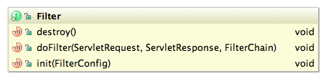
Filter
The Web Container Model
Create a class implementing the javax.servlet.Filter interface
Define the methods :
init(FilterConfig)
doFilter(ServletResquest, ServletResponse, FilterChain)
destroy()

Slide 67
Filter
The Web Container Model
In the doFilter method
Use the doFilter(ServletRequest, ServletResponse) of the FilterChain to call the next element in the chain
Can be another Filter
Can be the targeted Servlet
Instructions before this statement will be executed before the Servlet
Instructions after this statement will be executed after the Servlet
If the doFilter(…) method of the FilterChain isn’t called, the chain will be broken

Slide 68
Filter
The Web Container Model
Example :
public final class HitCounterFilter implements Filter {
//...
public void doFilter(ServletRequest request,
ServletResponse response, FilterChain chain) {
Counter counter = (Counter) filterConfig.
getServletContext().getAttribute("hitCounter");
System.out.println("The number of hits is: "
+ counter.incCounter());
chain.doFilter(request, response);
}
//...
}

Slide 69
Filter
The Web Container Model
Declare your filter in the web.xml file :
<filter>
<filter-name>MyHitCounterFilter</filter-name>
<filter-class>
com.supinfo.sun.filters.HitCounterFilter
</filter-class>
</filter>
<filter-mapping>
<filter-name>MyHitCounterFilter</filter-name>
<url-pattern>/*</url-pattern>
</filter-mapping>

Slide 70
Cookies
The Web Container Model
Can be placed in an HttpServletResponse
Can be retrieved in an HttpServletRequest
Constructor :
Cookie(String name, String value)
Methods :
String getName()
String getValue()

Slide 71
Cookie example
The Web Container Model
Add a cookie to a response :
Retrieve cookies from the request :
// ...
Cookie myCookie = new Cookie("MySuperCookie",
"This is my cookie :)");
response.addCookie(myCookie);
// ...
// ...
Cookie[] list = request.getCookies();
for(Cookie c : list) {
System.out.println("Name: " + c.getName()
+ " Value: " + c.getValue());
}
// ...

Slide 72
Stop-and-think
The Web Container Model
Do you have any questions ?
???

Slide 73
Exercises (1/2)
SupCommerce
Create a new HttpServlet
Name it LoginServlet
Bind it to /login url-pattern
Override the doPost(…) method
Retrieve the username passed into the request and add it as session attribute
Forward the request to the listing servlet
Create a file named login.html in WebContent folder
Define a form inside with a text field named username
Define the login servlet url-pattern as action

Slide 74
Exercises (2/2)
SupCommerce
Create a new Filter class
Named AuthenticateFilter
Bind to /auth/* url-pattern
In the doFilter(…) method
Check if the username session attribute exists
If it does, just call the next element of the chain
If it doesn’t redirect the user to the login form
Add /auth at the beginning of the url-pattern of
InsertSomeProductServlet
Test that your AuthenticateFilter and LoginServlet work !

Slide 75
What’s new in Servlet 3.0 ?
Servlets
Annotations, Web Fragments, …

Slide 76
Introduction
What’s new in Servlet 3.0 ?
The 10th December 2009, Sun Microsystems releases Java EE 6
It includes a lot of new JSR like :
EJB 3.1
JPA 2.0
CDI 1.0
… and Servlet 3.0 !
For more information about JSRs include in Java EE 6 :
http://en.wikipedia.org/wiki/Java_EE_version_history

Slide 77
Introduction
What’s new in Servlet 3.0 ?
Servlet 3.0 includes three mains evolutions :
Configuration through annotations
Web Fragments
Asynchronous execution (for Comet architectures)
We’re going to see the two first !

Slide 78
Configuration through annotations
What’s new in Servlet 3.0 ?
Annotations are used more and more in Java development :
To map classes with tables in database (JPA)
To define validation rules (Bean Validation)
And now to define Servlets and Filters without declare them into deployment descriptor !
So why not have seen this from the beginning ?
Because Servlet 2.5 is still extremely used
And you can still used deployment descriptor with Servlet 3.0

Slide 79
Configuration through annotations
What’s new in Servlet 3.0 ?
The main annotations in Servlet 3.0 are :
@WebServlet : Mark a class as a Servlet (must still extends HttpServlet)
Some attributes of this annotation are :
name (optional) :
The name of the Servlet
urlPatterns :
The URL patterns to which the Servlet applies

Slide 80
Configuration through annotations
What’s new in Servlet 3.0 ?
The main annotations in Servlet 3.0 are :
@WebFilter : Mark a class as a Filter (must still implements javax.servlet.Filter)
Some attributes of this annotation are :
filterName (optional) :
The name of the Filter
servletNames (optional if urlPatterns) :
The names of the servlets to which the Filter applies
urlPatterns (optional if servletNames) :
The URL patterns to which the Filter applies

Slide 81
Configuration through annotations
What’s new in Servlet 3.0 ?
Examples :
@WebServlet(urlPatterns="/myservlet")
public class SimpleServlet extends HttpServlet {
...
}
@WebFilter(urlPatterns={"/myfilter","/simplefilter"})
public class SimpleFilter implements Filter {
...
}

Slide 82
Web Fragments
What’s new in Servlet 3.0 ?
New system which allow to partition the deployment descriptor
Useful for third party libraries to include a default web configuration
A Web Fragment, as Deployment Descriptor, is an XML file :
Named web-fragment.xml
Placed inside the META-INF folder of the library
With <web-fragment> as root element

Slide 83
Web Fragments
What’s new in Servlet 3.0 ?
Example :
<!-- Example of web-fragment.xml -->
<web-fragment>
<name>MyFragment</name>
<listener>
<listener-class>
com.enterprise.project.module.MyListener
</listener-class>
</listener>
<servlet>
<servlet-name>CutomServletInFragment</servlet-name>
<servlet-class>
com.enterprise.project.module.MyServlet
</servlet-class>
</servlet>
</web-fragment>

Slide 84
Stop-and-think
What’s new in Servlet 3.0 ?
Do you have any questions ?
???

Slide 85
Exercises
SupCommerce
It’s time to be modern !
Remove the Deployment Descriptor of your project
Update your Servlets and your Filter to use Servlet 3.0 annotations

Slide 86

Course summary
Servlets
Create a Servlet
Declare a servlet in the web.xml
Attribute Scopes
Create a Filter
Request Dispatcher
Servlet 3.0 evolutions

Slide 87


Servlets
For more
If you want to go into these subjects more deeply, …
Publications
Java EE
Guide de développement d'applications web en Java
Jérôme LAFOSSE
Available on http://librairies.supinfo.com
ENI Editions
Web sites
http://www.oracle.com/technetwork/java/index-jsp-135475.html

Slide 88


The end
Servlets

